Slide 1


Project Presentation
On
“ C I N E M A - H U B ”
BIT-2nd Semester
Group Members:
1. Sagar Upadhyaya (324529)
2. Shubham Ghimire (324531)
3. Dhiraj Sapkota (324513)

Slide 2

Contents
Introduction
Objective
Literature Review
Features
Algorithm
Flowchart
Gantt Chart (Time Scheduling)
Conclusion
References (APA Format)

Slide 3
Introduction
CINEMA HUB is the project that helps in maintaining different management records like movie details and cinema details in cinema along with its ticket booking related information.
The records includes cinema details, movie details, customer details, booking & billing details, manager details and so on.

Slide 4
OBJECTIVES
1
To Provide User The Ticket Booking Facilities Of Movie

Slide 5
Literature review
During our research we found some management and ticket booking related project that has already been developed. But those projects were lacking some of the important features. The interface of the project wasn’t user friendly, and this system also lacked security function. Likewise, those projects didn’t have the feature to manipulate some of the records. Hence, we included all the mentioned features in our program CINEMA HUB.
PROJECT REFERENCES:
Ticket Reservation System

Slide 6
Limitation of existing system
1
Lacked to manipulate different records like movie details
2
Lacked to maintain validation of the records
3
Unmanaged seats booking process
4
No provision of control and access to authorized individuals

Slide 7



Features
1
Booking of different seats of cinema
2
Cancelation of existing booked movies
3
Different logins for users
4
Billing of movie tickets

Slide 8
ALGORITHM
Step 1: Start
Step 2: Display Login Interface: choose
Admin login
Manager login
Staff login
Customer login
Exit
Step 3: if user choose 1 go to step 4
Else if user choose 2 go to step 37
Else if user choose 3 go to step 41
Else if user choose 4 go to step 52
Else terminate the program
Step 4: Display admin registration form if
already register then go to
step 5 else register and go to step 5
Step 5: Display login page for admin
Step 6: Input username and password if true
then display login successful
and go to step 7 else display
Error !! Please try again and goto step 5
Step 7: Display Admin menu choose:
Manage manager
Manage Staff
Manage Cinema
Manage Movie
Book movie
Exit
Step 8: if user choose 1 go to step 9
Else if user choose 2 go to step 16
Else if user choose 3 go to step 23
Else if user choose 4 go to step 30
Else if user choose 5 go to step 61
Else go to previous menu i.e., step 2
Step 9: Display manage manager page choose:
Add
Remove
View
Modify
Search
Back

Slide 9
ALGORITHM
Step 10: if user choose 1 then display form to add manager
and go to step 11
Else if user choose 2 then go to step 12
Else if user choose 3 then go to step 13
Else if user choose 4 then go to step 14
Else if user choose 5 then go to step 15
Else go to previous menu i.e. step 9
Step 11: Input Name, user id, Password, position, cinema
and phone no and return to step 9
Step 12: Input The manager id to remove particular manager record
and press Yes/No and return to step 9
Step 13: Display Manager records like Name, user id, Password, position,
cinema and phone no and return to step 9
Step 14: Input manager id to modify the particular manager record,
modify it and return to step 9
Step 15: Input manager id to show the particular manager record
and return to step 9
Step 16: Display manage Staff page choose:
1.Add 2.Remove 3.View
4. Modify 5.Search 6.Back
Step 17: if user choose 1 then display form to
add staff and go to step 18
Else if user choose 2 then go to step 19
Else if user choose 3 then go to step 20
Else if user choose 4 then go to step 21
Else if user choose 5 then go to step 22
Else go to previous menu i.e step 16

Slide 10
ALGORITHM
Step 24: if user choose 1 then display form to add cinema and go to step 25
Else if user choose 2 then go to step 26
Else if user choose 3 then go to step 27
Else if user choose 4 then go to step 28
Else if user choose 5 then go to step 29
Else go to previous menu i.e. step 23
Step 25: Input Name, address, manager, no of staff and phone no and return to step 23
Step 26: Input cinema name to remove particular cinema record and press Yes/No and return to step 23
Step 27: Display cinema records like Name, address, manager, no of staff, no of Audi and phone no and return to step 23
Step 28: Input cinema name to modify the particular cinema record, modify it and return to step 23
Step 29: Input cinema name to show the particular cinema record and return to step 23
Step 18: Input Name, user id, Password, supervisor,
cinema and phone no and return to step 16
Step 19: Input the staff id to remove particular staff record and
press Yes/No and return to step 16
Step 20: Display staff records like Name, user id, Password,
Supervisor, cinema and phone no and return to step 16
Step 21: Input staff id to modify the particular staff record,
modify it and return to step 16
Step 22: Input staff id to show the particular staff record
and return to step 16
Step 23: Display manage cinema page choose:
1.Add 2.Remove 3.View
4. Modify 5.Search 6.Back

Slide 11
ALGORITHM
Step 30: Display manage movie page choose:
1.Add 2.Remove 3.View
4. Modify 5.Search 6.Back
Step 31: if user choose 1 then display form to add movie and
go to step 32
Else if user choose 2 then go to step 33
Else if user choose 3 then go to step 34
Else if user choose 4 then go to step 35
Else if user choose 5 then go to step 36
Else go to previous menu i.e. step 30
Step 32: Input movie Name, Release-date, major cast, director
and time of show and return to step 30
Step 33: Input movie name to remove particular movie record
and press Yes/No and return to step 30
Step 34: Display cinema record like Name, Release-date, major cast, director and time of show and return to step 30
Step 35: Input movie name to modify the particular movie record,
modify it and return to step 30
Step 36: Input movie name to show the particular movie record
and return to step 30
Step 37: Display login page for manager
Step 38: Input username and password if true then
display login successful and go to step 39
else display Error!! try again and goto step 37
Step 39: Display manger menu choose:
Manage Staff
Manage Movie
Book movie
Exit
Step 40: if user choose 1 go to step 16
Else if user choose 2 go to step 30
Else if user choose 3 go to step 61
Else go to previous menu i.e. step 2

Slide 12
ALGORITHM
Step 41: Display login page for staff
Step 42: Input username and password if true
then display login successful
and go to step 43 else display
Error!! Please try again and goto step 41
Step 43: Display staff menu choose:
Manage client
Book movie
Exit
Step 44: if user choose 1 go to step 45
Else if user choose 2 go to step 61
Else go to previous menu i.e. step 2
Step 45: Display manage customer page choose:
1.Add 2.Remove 3.View
4. Modify 5.Search 6.Back
Step 46: if user choose 1 then display form to add customer and go to step 47
Else if user choose 2 then go to step 48
Else if user choose 3 then go to step 49
Else if user choose 4 then go to step 50
Else if user choose 5 then go to step 51
Else go to previous menu i.e step 43
Step 47: Input customer Name and password and
return to step 45
Step 48: Input customer name to remove customer and press Yes/No and return to step 45
Step 49: Display customer details like name, no of customer and return to step 45
Step 50: Input customer name to modify the customer record and return to step 45
Step 51: Input customer name to show the customer record and return to step 45

Slide 13
ALGORITHM
Step 52: Display login option for customer choose:
Login
Register
Exit
Step 53: if user choose 1 then display customer login form
and go to step 54
Else if user choose 2 then display registration form go to step 55
Else go to previous menu i.e. step 2
Step 54: Input username and password if true then go to step 56
else display Error!! Please try again and goto step 52
Step 55: display customer register and after registration go to step 54
Step 56: display customer menu: choose
Modify pass
History
Book movie
Exit
Step 57: if user choose 1 then
display password changing form and go to step 58
Else if user choose 2 then go to step 59
Else if user choose 3 then go to step 61
Else go to previous menu i.e 52
Step 58: Input username, current password,
new password and configure password and
if login succesful goto step 52
else display Error!! Please try again and
goto step 57
Step 59: Display the history page
Step 60: Display the movie list along with name that
customer has booked and goto step 56

Slide 14
ALGORITHM
Step 61: input valid customer id and contact number
Step 62: display available cinema
Step 63: choose appropriate cinema
Step 64: display available movie
Step 65: choose appropriate movie
Step 67: display available time
Step 68: choose appropriate time
Step 69: display Audi
Step 70: choose no. of seats you want to book
Step 71: display Are you sure you want to book(Y/N)
Step 72: If yes display your ticket is booked successfully and goto step 74
Step 73: If no display sorry your booking is cancelled and goto step 56
Step 74: display billing information and goto step 56
Step 75: stop

Slide 15
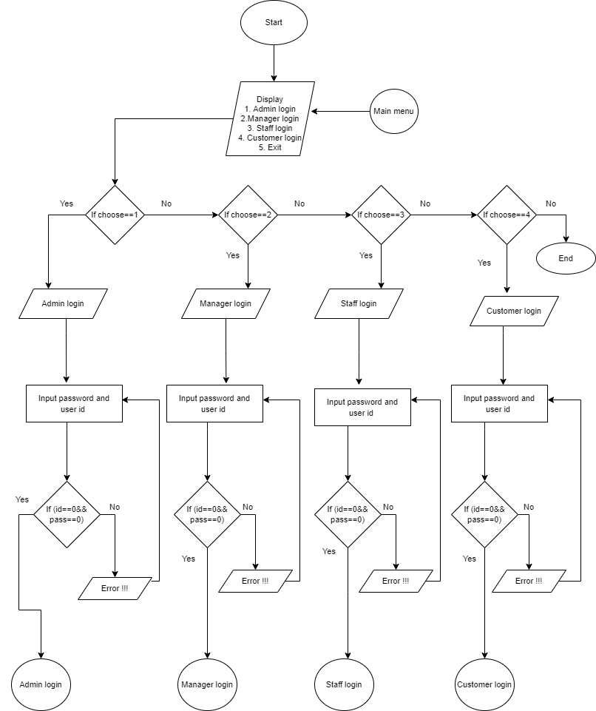
FLOWCHART

Slide 16
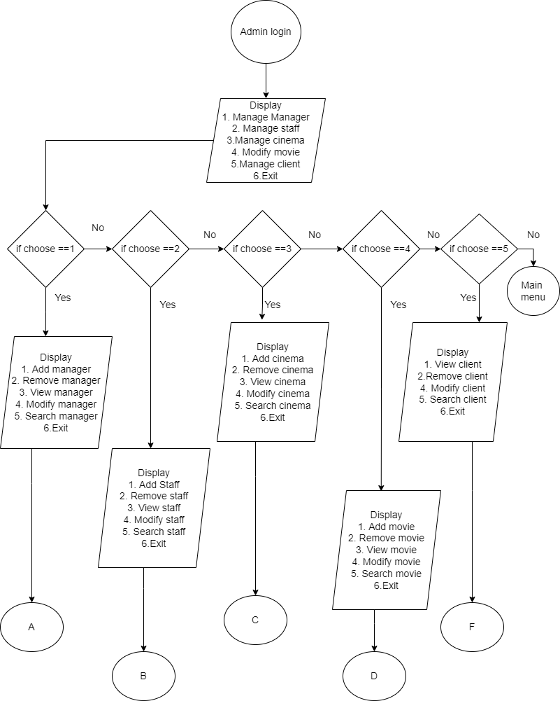
FLOWCHART

Slide 17
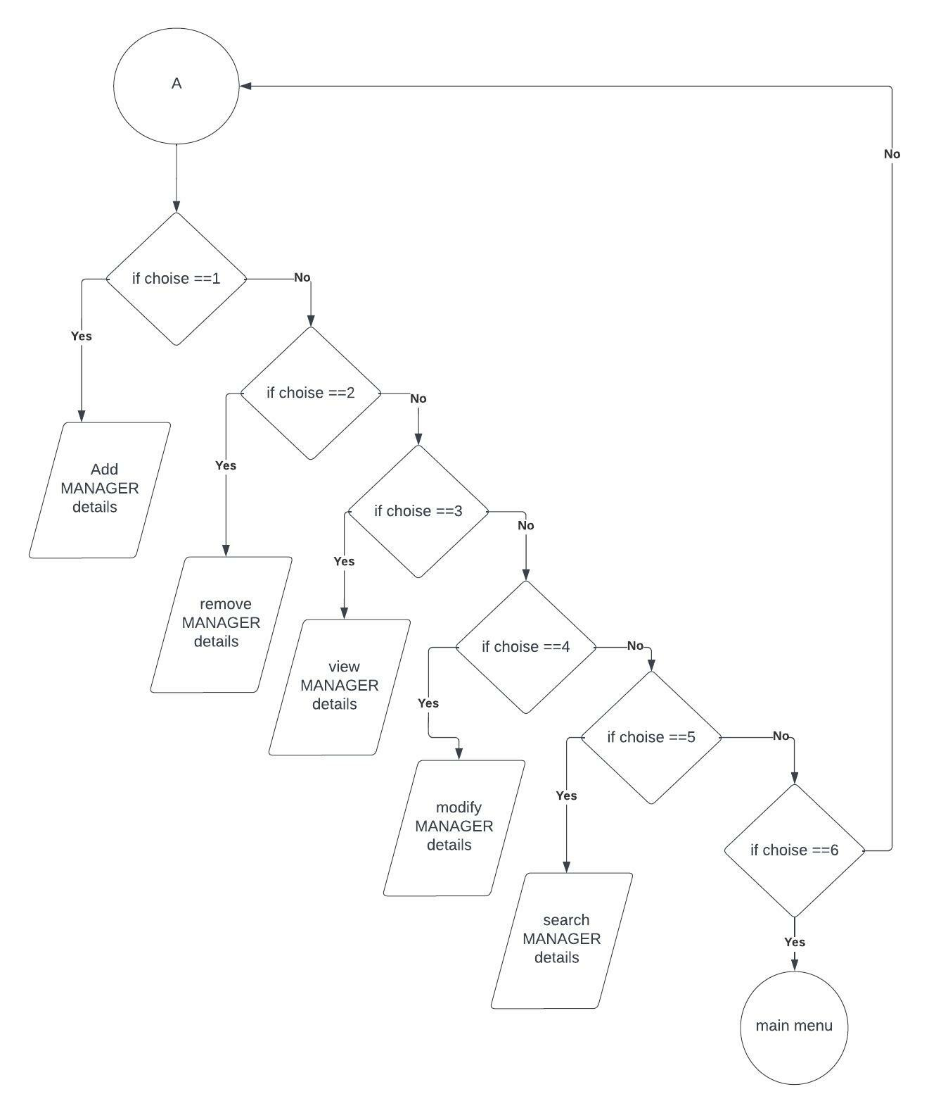
FLOWCHART

Slide 18
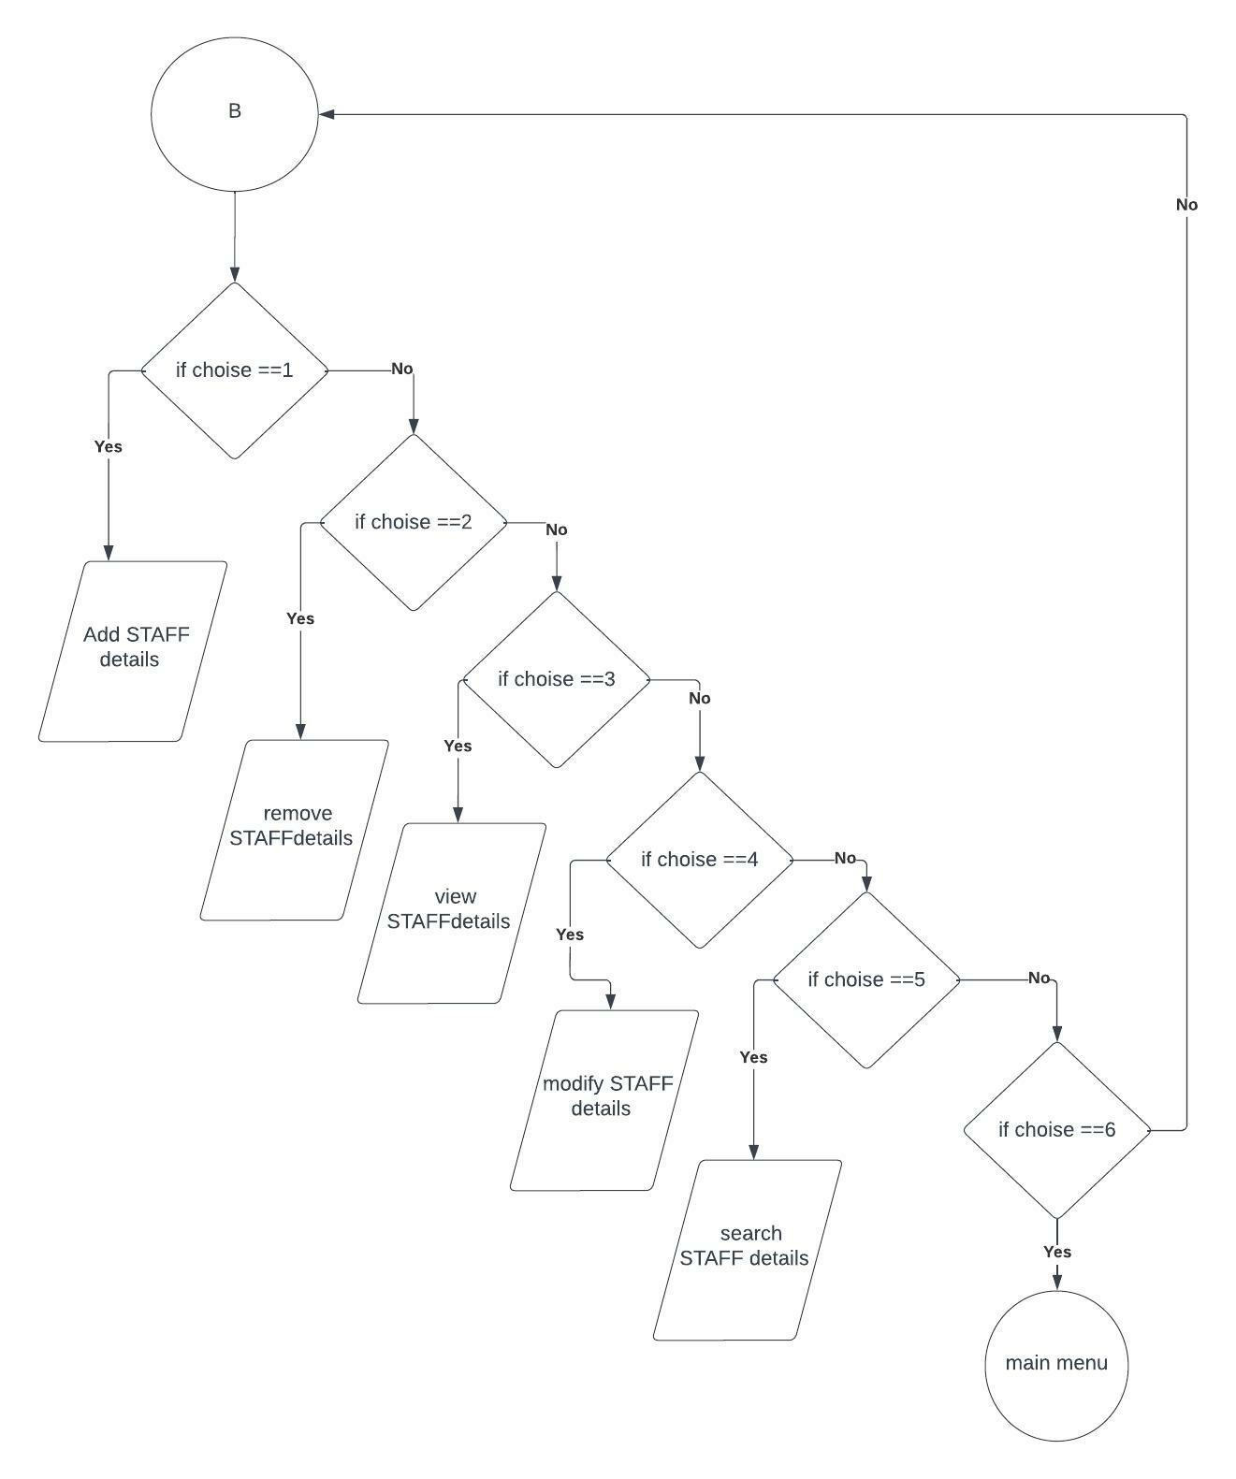
FLOWCHART

Slide 19
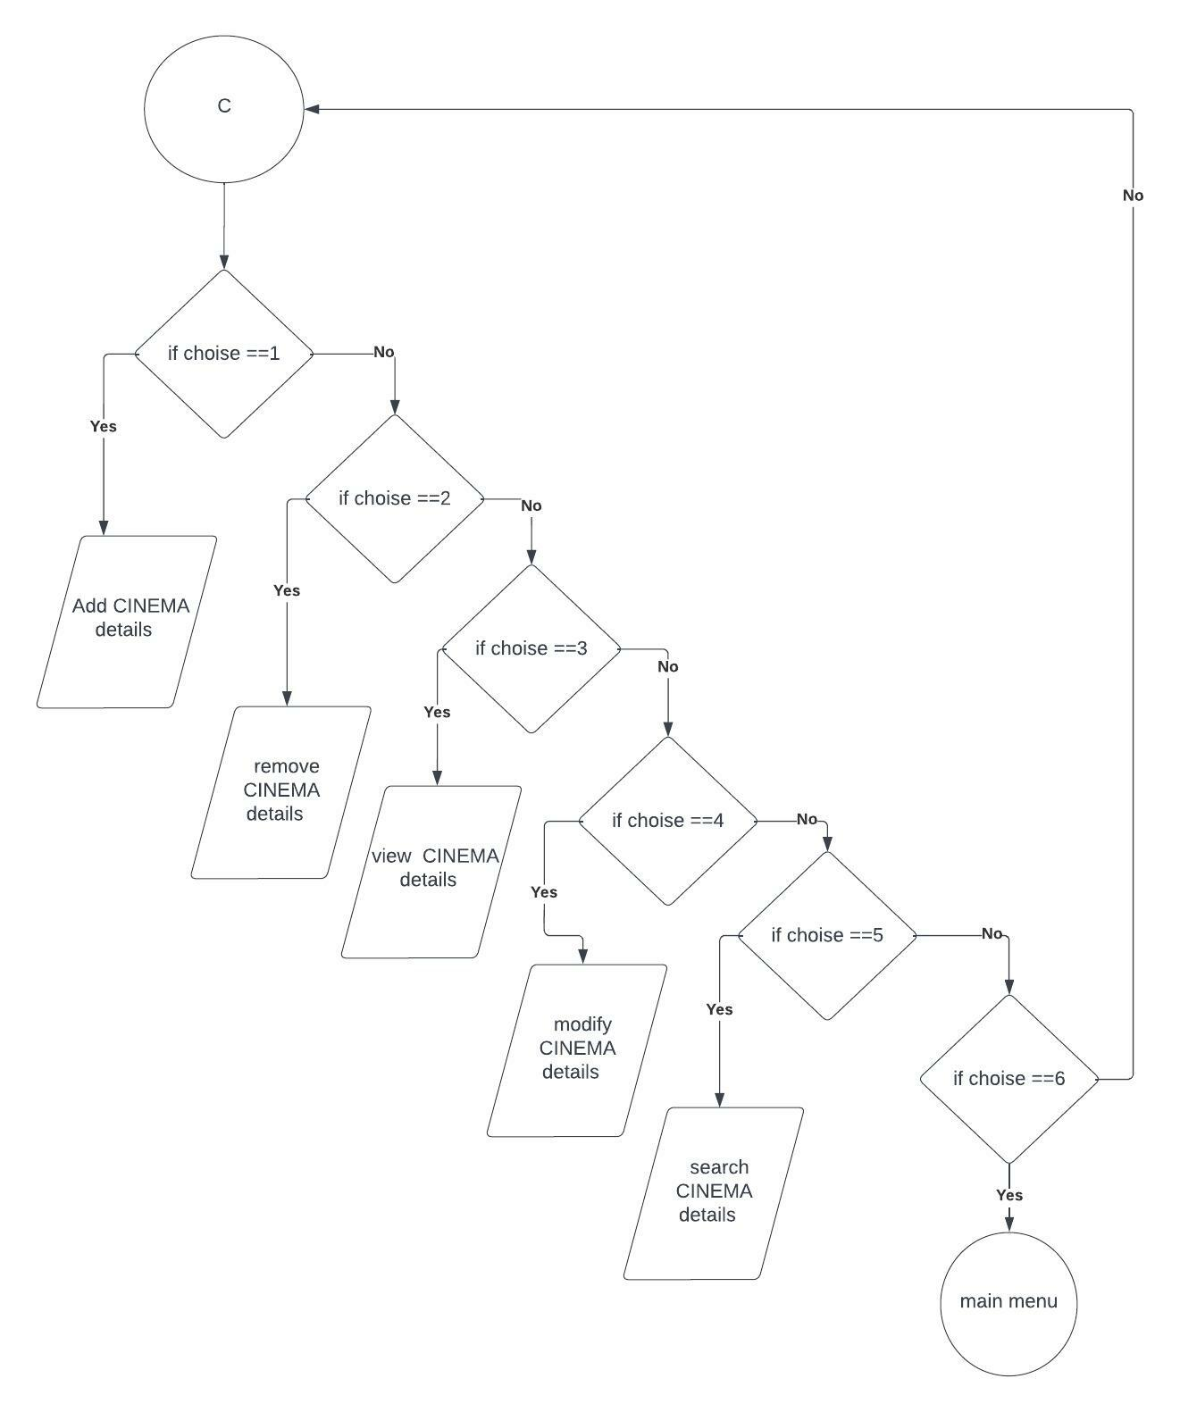
FLOWCHART

Slide 20
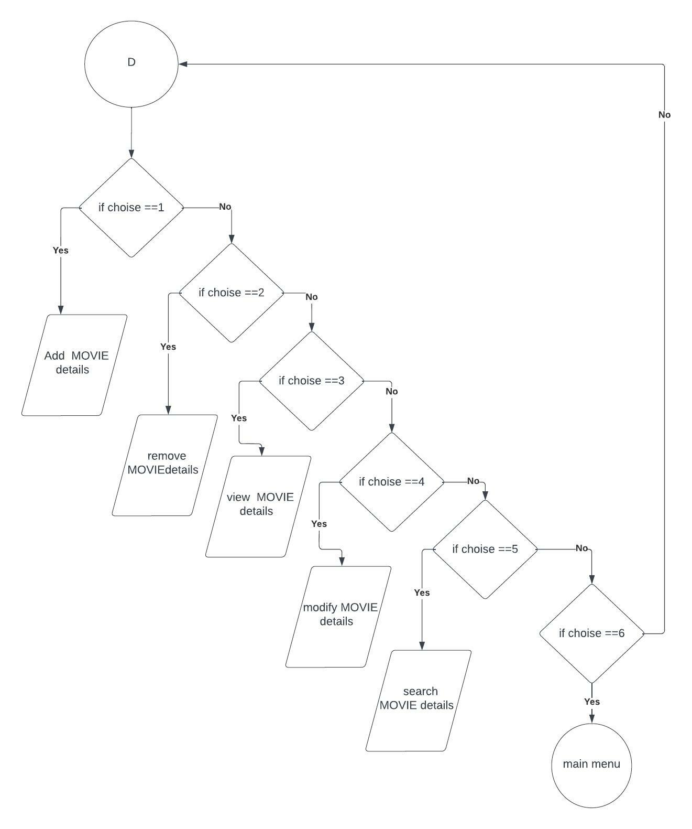
FLOWCHART

Slide 21
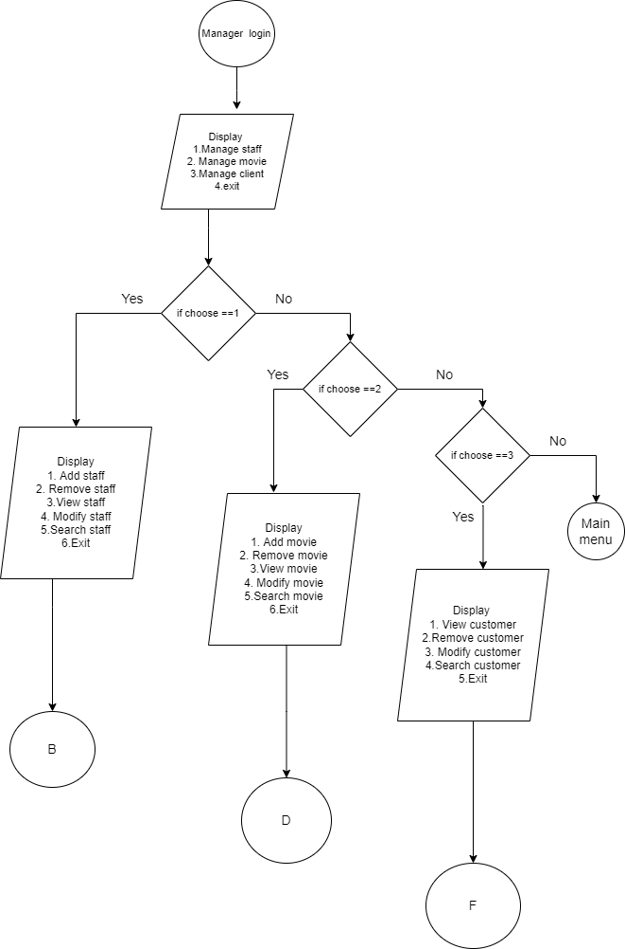
FLOWCHART

Slide 22
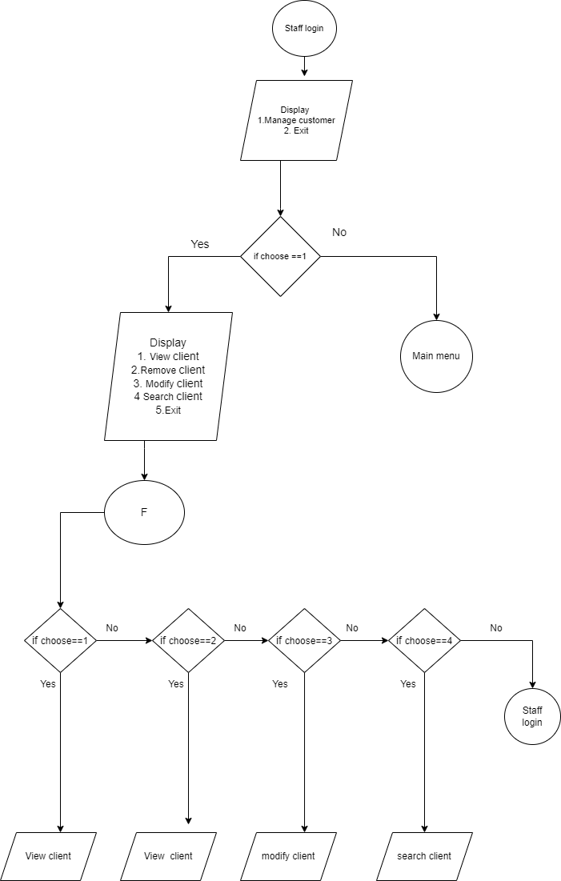
FLOWCHART

Slide 23
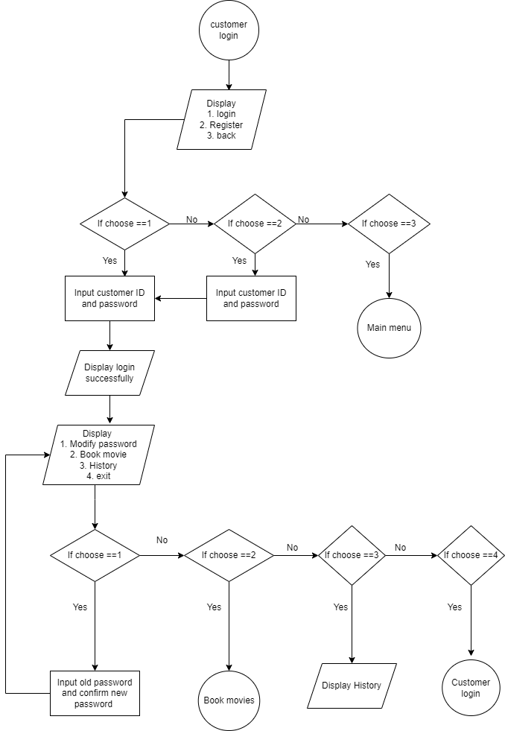
No
No

Slide 24
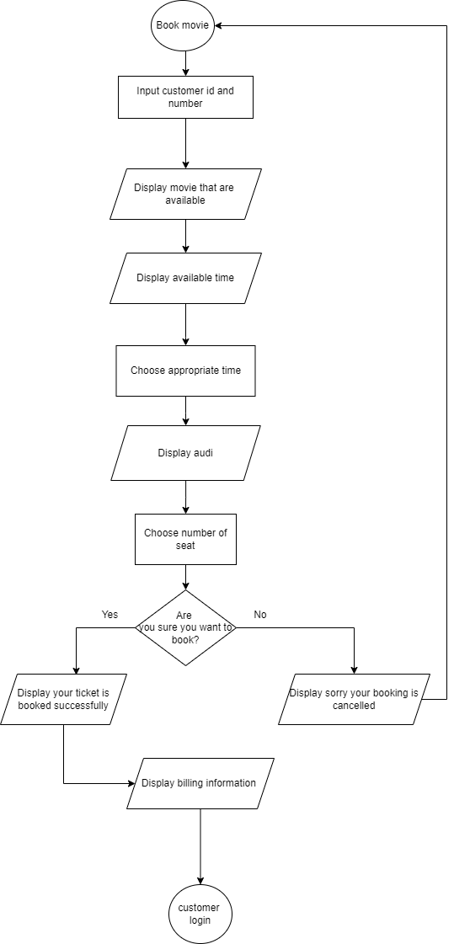

Slide 25
GANTT CHART
Task Name | 2022
 | March 1 | April1 | May 1 | June 1 | July 1 | Aug 26
System Analysis
System Design
Coding
Debugging and Testing
Documentation

Slide 26
conclusion
After the completion of this project CINEMA HUB, we have meet our required objectives. User can book movie tickets and manage different records of manager, cinema, movie, and customer with the use of this project.

Slide 27
references
Balaguruswamy, E(2011). Object oriented programming with C++. New delhi, tata mcgraw hill education private limited.
Abiral, b (29 june 2011). Project on c++ programming. Retrieved july 2, 2022, from https://www.Scribd.Com/document/58979208/project-on-c++-programming
Sasidhar, K (16 sep 2014). Mini project on c++. Retrieved july 22, 2022
Tutorials points, (jan 4,2015). C++ tutorial. Retrieved aug 10, 2022
Jaydeep, D(n.D). 50+ interesting c++ project. Retrieved aug 02, 2022
Codewithcteam, (22 mar 2018). 50++ C++ project. Retrieved aug 04, 2022

Slide 28


Slide 29


